Slide 1




DELIVERY METHODOLOGY & OUTCOMES
A more complex approach to handling imbalances
.
Services + Solutions
Class Weight or Loss Function Application
Performance Metrics Selection
Goal in Metric Selection
Models Performance Evaluation
ctiv
ADVISE
Reprocessing the entire transactions after building the model?
Class Weight or Loss Function to increase the cost of the failing minority class
REVIEW
Forget the Accuracy Metric
Classification Report & Confusion Matrix
OPERATE
Optimize Performance on the imbalance production
Recall & Precision
Confusion Matrix
EVALUATE
Result-driven Decision
Classifiers results: ANNs, XGBoost, Random Forest, Decision Trees
Conduct cost benefit
analysis related to false positives/negatives
Notes:
No need to rebalance the entire dataset after building the model – Disadvantages of Smote / Resampling techniques
Weighted Loss Function or Class Weight – To give the failing minority class a higher cost – May Slightly underperform compared to rebalancing data, only theoretically
Accuracy use on imbalance data – Very high but bias your perception of best performer
Goal – Optimize performance – Find a balance that works best in production
Observe and Interpret performance results – XGBoost , F1-Score (Recall + Precision), Confusion Matrix

Slide 2
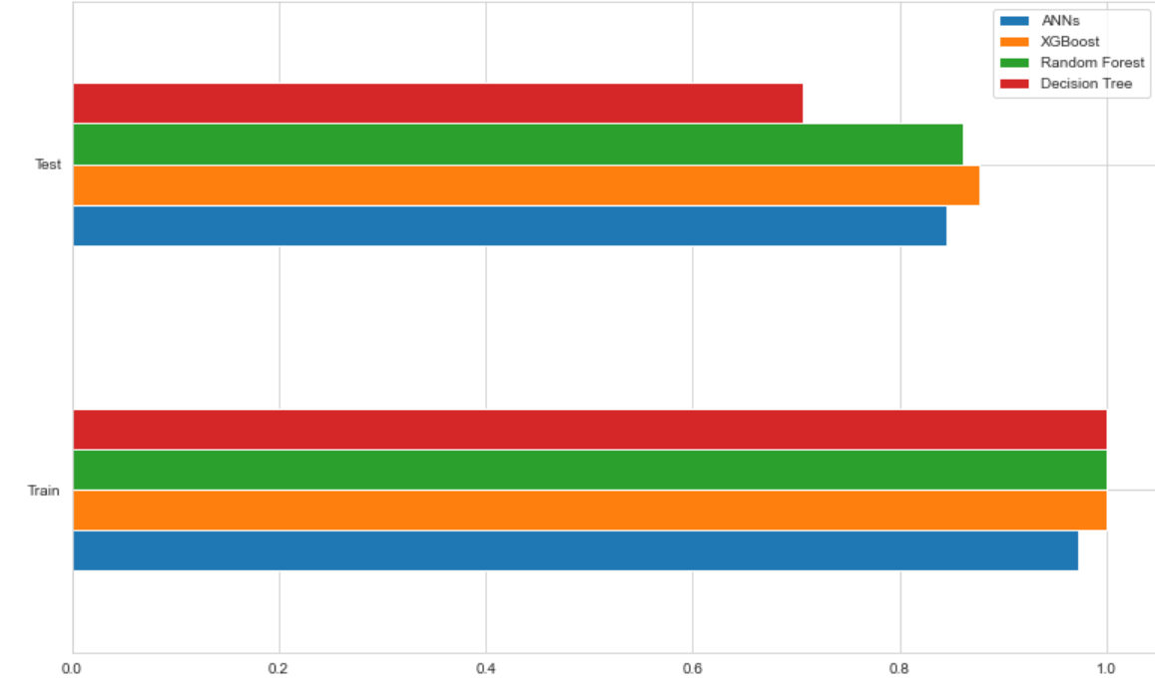
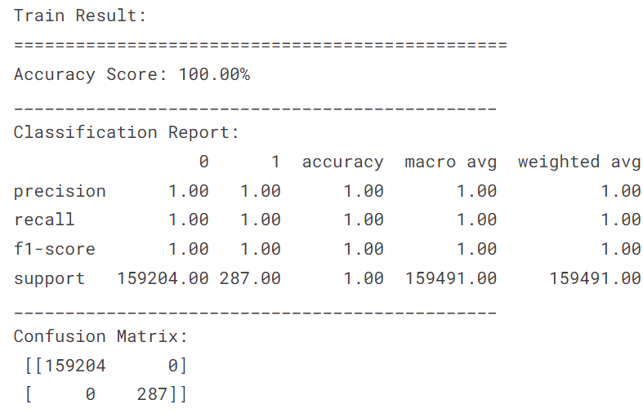
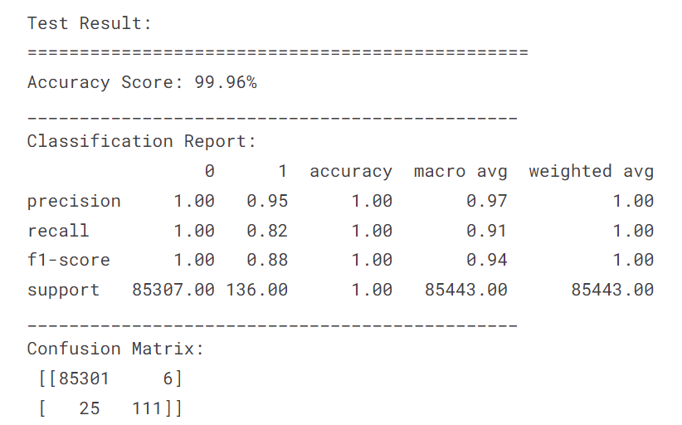
XGBoost: Classification model used for imbalanced data.
Best Performer – XGBoost Model
Notes:
Boosting: is an ensemble technique to combine weak learners to create a strong learner that can make accurate predictions
XGBoost (Extreme Gradient Boosting) is an advanced and more efficient implementation of Gradient Boosting Algorithm. It is 10 times faster than the normal Gradient Boosting as it implements parallel processing.
XG Boost is a very powerful algorithm but given lots and lots of data, even XG Boost takes a long time to train.
Correctly identifying 111 of them as fraudulent Missing 9 fraudulent transactions At the cost of incorrectly flagging 25 legitimate transactions

